Slide 1
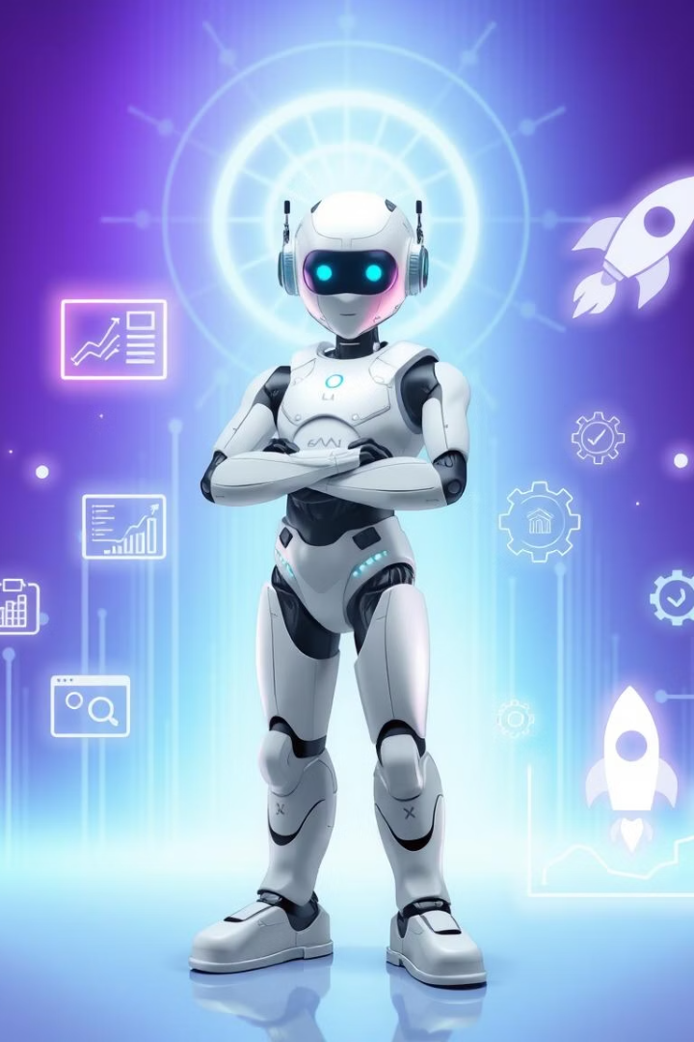
Project Management Co-Agent
AI-Powered ClickUp Assistant
Leveraging AI to streamline and accelerate your project management.
Group Members
Syed Muhammad Shees Ali CT-22088
Abdul Rafay Ul Iman Syed CT-22099
Muhammad Huzaifa Qureshi CT-22081

Slide 2
Project Overview
Seamless Integration
AI Meets PM
Dual Architecture
This system integrates smoothly with ClickUp, enhancing productivity.
Combines AI analysis with real-time task and project management.
Python backend agent (LangGraph/Gemini)
Modern Next.js copilot UI

Slide 3
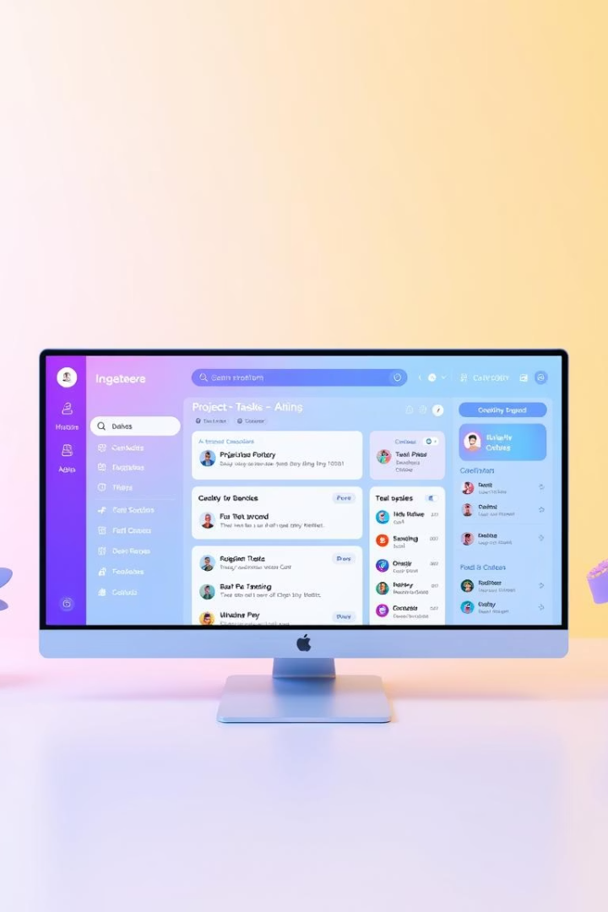
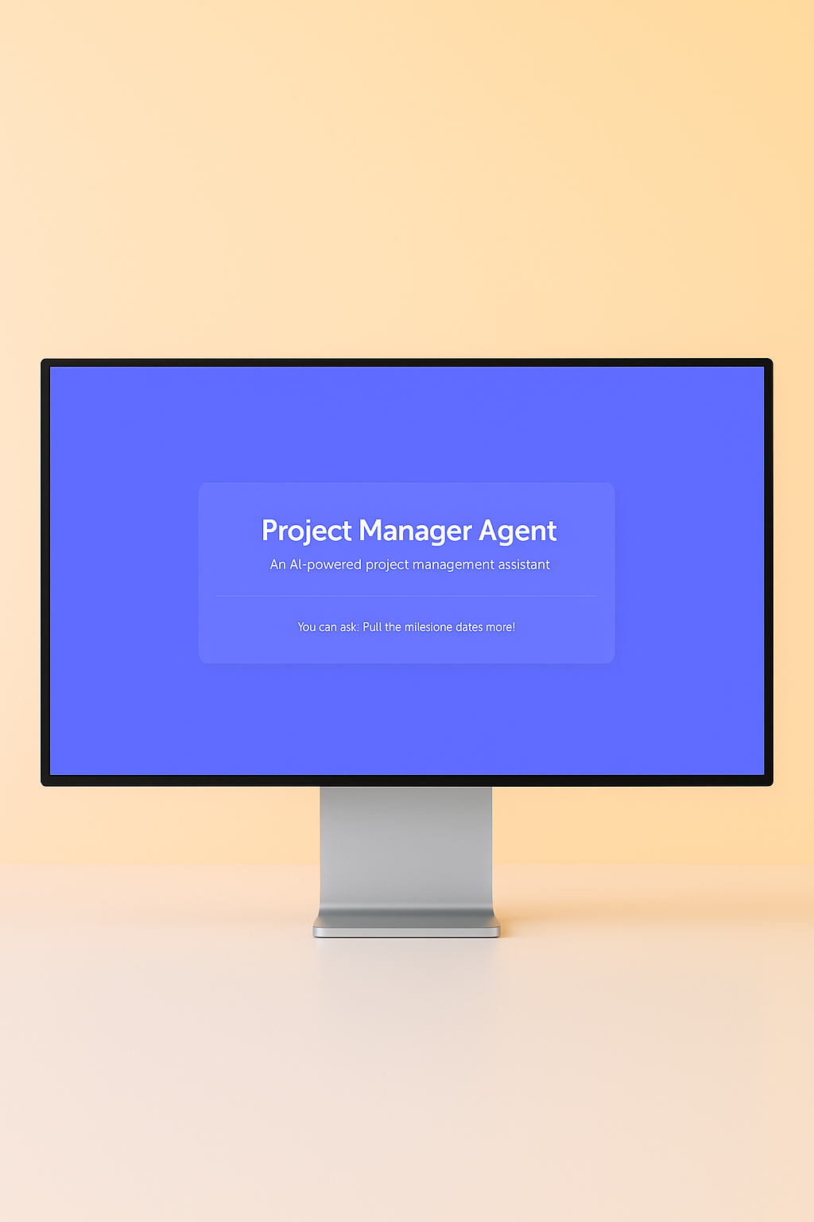
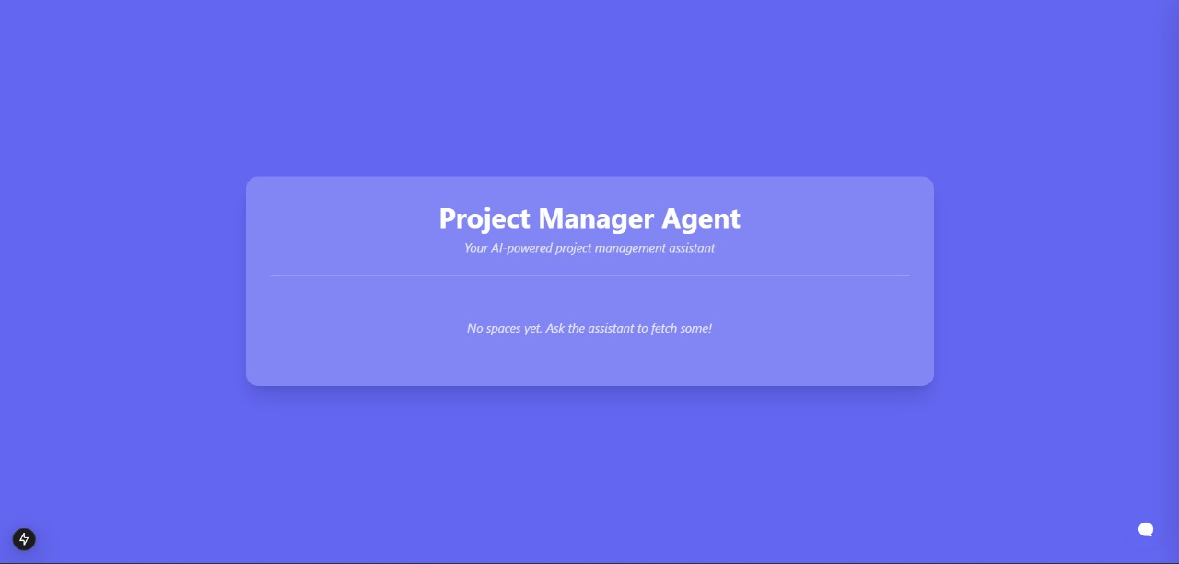
Key Features
Multi-Level Visualization
View Spaces, Lists, and Tasks in a clear hierarchy.
AI-Enhanced Operations
Smart task creation and updates
Custom field management
Timeline optimization
Dual Interface Control
Natural language processing
Direct UI interaction
Tech Highlights
Live API synchronization
Gemini/OpenAI decision making
Bi-directional task management

Slide 4
Technical Deep Dive
Backend Stack
Frontend Stack
Python 3.12 with LangGraph orchestration
Next.js 14 + TypeScript
Google Gemini AI processing
CopilotKit interactive UI
FastAPI endpoints
Real-time state & Tailwind CSS
Secure credential management
Secure API communication

Slide 5



Setup & Installation
Backend Preparation
Python venv & Gemini/ClickUp keys setup
Integrate LangGraph Studio
Frontend Setup
Install pnpm dependencies
Configure CopilotKit
Dual Runtime Launch
Run uvicorn agent:app
Run pnpm dev server
Prerequisites: ClickUp team, Google AI Studio, modern Node & Python.

Slide 6
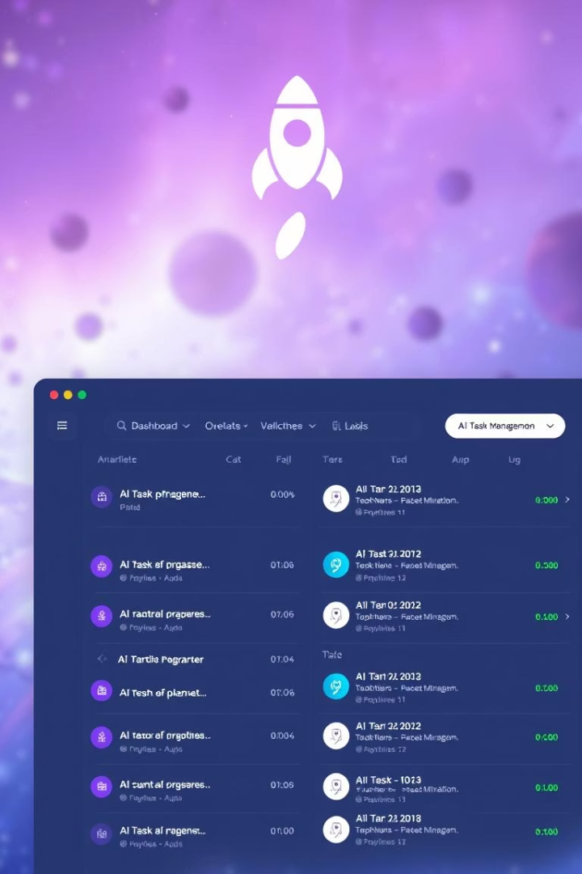




Use Cases & Examples
Project Health
Rapid Task Mgmt
Timeline Optimization
Track overdue tasks with clear, actionable insight.
Create urgent tickets instantly via voice or text.
Auto-reschedule deliverables based on real-world changes.
Sample prompts for dynamic AI task operations included.

Slide 7
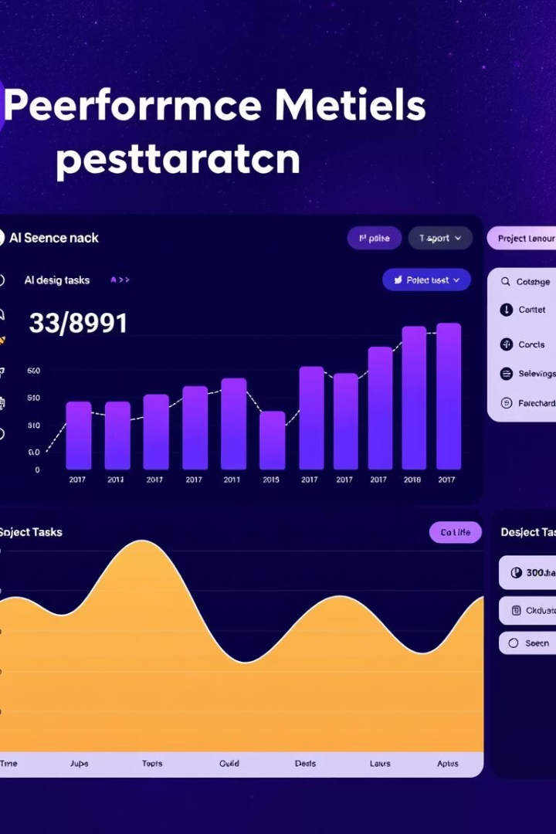
Why This Matters
70% Faster Operations
AI co-pilot accelerates task management workflows.
Context-Aware Decisions
AI understands project context for smarter outcomes.
Unified Interface
Simple for technical and non-technical users alike.
Enterprise-Ready
Secure credentials, scalable workflows, full audit trails.

Slide 8

Future Implementation
Voice Commands
Support for spoken requests.
Template Library
Save common workflows (e.g., “Weekly sprint setup”).
Cross-Platform Sync
Add integration with Google Calendar/Slack.

Slide 9
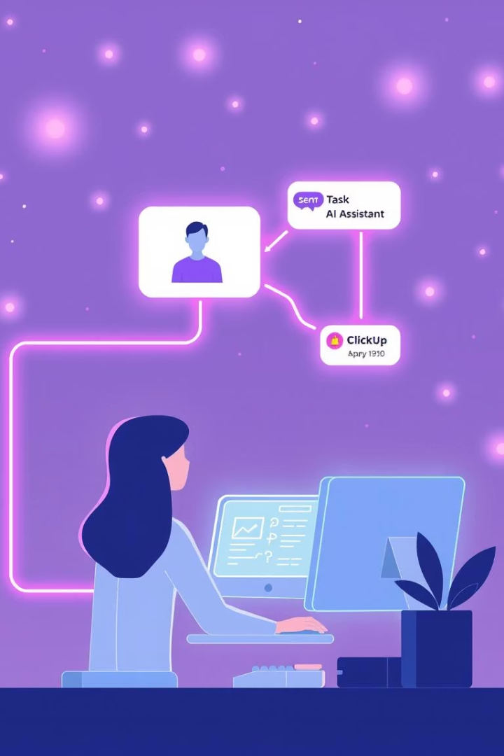
Get Started Today
Clone Repository
Download codebase to start customization and development.
Configure Environment
Set up .env files with API keys and secrets.
Explore LangGraph Studio
Visualize and extend AI workflows seamlessly.
Q&A: Let’s discuss how AI transforms project management!

